Slide 1
Physical Design Week 4
RAID, Indexes, B-Trees, Triggers
Dr. Pierpaolo Dondio,
DT228/4

Slide 2



Physical database design
Process of producing a description of the implementation of the database on secondary storage. It describes the relations, file organizations, and indexes used to achieve efficient access to the data, and any associated integrity constraints and security measures.
Conceptual (ER)
Logical (Relational)
Physical

Slide 3
Agenda
Disks Organisation
Files Organisation
Indexes
Triggers & Constraints
Other Implementation Issues

Slide 4
RAID
Redundant Array of Independent Disks

Slide 5
Two problems with disks: performance and reliability
Disks are slow, we need a way to improve performance
Disks are subject to hardware failure, we need a way to protect our data
Solutions:
When using a single disk, we described scheduling techniques to improve reading/writing performance
If the disk fails, data are lost!
If we have multiple disks available, another solution is represented by RAID systems. Idea:
we can improve performance spreading data across disks
we can improve reliability with redundancy (using spare disks)
RAID is a way of organizing data over multiple disks to increase performance and reliability

Slide 6
What is RAID?
Redundant Array of Independent Disks
The idea is to have more than one physical disk and spread or/and duplicate your data across multiple disks in order to improve performance and/or reliability
Anyway, the cost is increasing since we need to buy and maintain more disks + the hardware needed to make the system working
RAID SYSTEM
D1
D2
D3
Controller

Slide 7
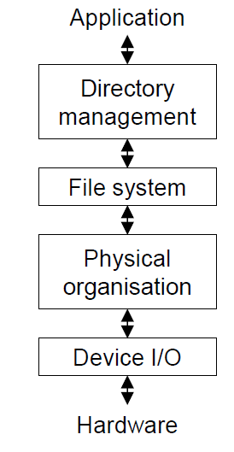
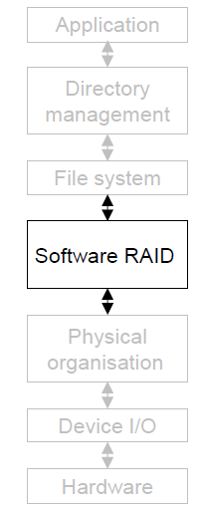
Where is RAID?
Raid is a way of organizing file systems over more than one physical disk.
It can also be software-only (part of the OS). Windows or Unix have RAID implementation
It is usually hardware assisted (controllers, dedicated buses)
Rationale
Disk Unit costs is decreasing
Mission Critical Systems

Slide 8
Performance Criteria of RAID levels
Speed: read and write performance
Redundancy: level of reliability. If a disk fails, can I recover my data? What if two disk fail?
Cost: how much is the cost of the RAID implementation?
Storage Efficiency: how much storage is needed to store data. Since data might be replicated or control data might be added to your data, not all the disk space is used efficiently for your data, but only part of it

Slide 9
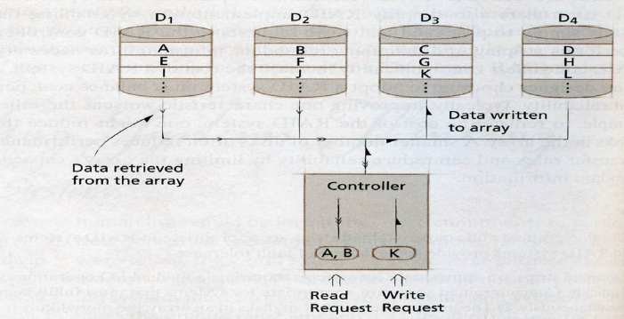
RAID 0 - Striping
Data blocks spread over disks. Two contiguous blocks on separate disks.
Granularity of stripes (size of a block sector) is very important
Fine-grained stripes (small block size, many disks used for big size file)
Coarse-grained strips (strip bigger. Generally files distributed over less disks. Waste of performance and space for small files)

Slide 10
RAID 0 - Striping
RAID 0
M
I
A
S
R
O
K
K
Stripe
Storage Efficiency: all the space used for data (no redundancy).
Redundancy NOT present (not a real RAID system). No Fault tolerance
Performance:
Reading: n times faster (ideally) than single disk
Writing: n times faster (ideally).
Read and write can overlap Ex: K can be written while reading A.
Very good if sequential
Can read and write at the same time (if requests are not conflicting)
The choice of the size of the block is vital
Cost: the lowest of all RAID

Slide 11
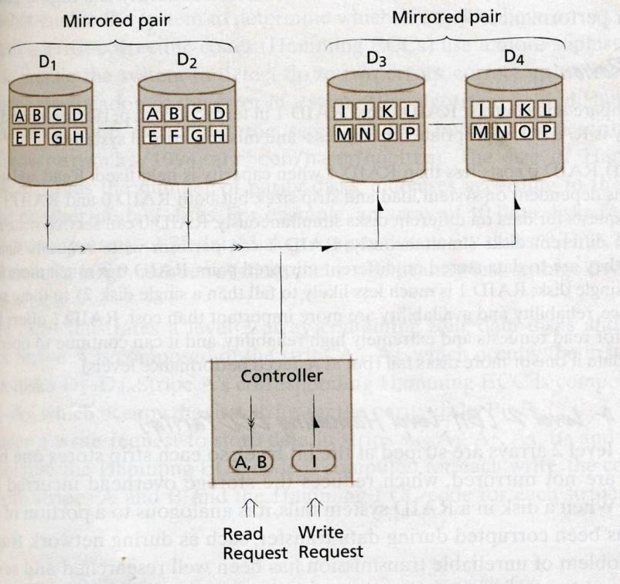
RAID 1 - Mirroring
Each data block has a copy on 1 or N disks.
Storage Efficiency: Only 1/N storage space is used. (In case of a mirrored pair, 50% wasted)
Complete Redundancy
Fault tolerant is very high.
Spare disk usually hot swappable

Slide 12
RAID 1 - analysis
RAID 1
O
K
O
K
High Costs. High Availability.
Performance
Writing: slower than average to the same mirror couple (wait the slower one).
Reading: improved, (read the fastest disk). Response time decreases by 33%
Multiple read, but no multiple write
It is not a substitute for backup!!

Slide 13
Exercises
1.
Suppose you have disks of size 20 GB
You have 50 GB of data
How many disk (at least) are needed for RAID 0?
How many disk (at least) for RAID 1?
If data are not critical, which system would you chose?
2.
If 1 mirrored disk fails, can you still keep on working?
3.
In a RAID 1 implementation where there are 2 copies for each disk, can you keep working if two disks are broken at the same time?
4.
Why the size of the block can affect performance?

Slide 14
Parity Bit
The parity bit is an extra-bit added to a sequence of data used to check for data errors
Suppose your data are a sequence of 5 bits
The parity bit has a value so that your data + the parity bit has an even number of ones
Bit 1 | Bit 2 | Bit 3 | Bit 4 | Bit 5 | Parity
0 | 1 | 1 | 0 | 1 | ??
Bit 1 | Bit 2 | Bit 3 | Bit 4 | Bit 5 | Parity
0 | 1 | 1 | 0 | 1 | 1

Slide 15
Parity Bit – why it is used?
Detect errors in your data
It can only detect, not correct data!
It can correct data only if the position of the error is known.
Example: Is the following data correct?
00110101 1
What if there are two errors?
I need more parity bit to detect them.
For instance the hamming code add 3 parity bits every 4 bits data to detect and correct errors
Why are they used with RAID?
If we store parity bits on a disk, the parity bit can be used to reconstruct the disk in case of failure

Slide 16
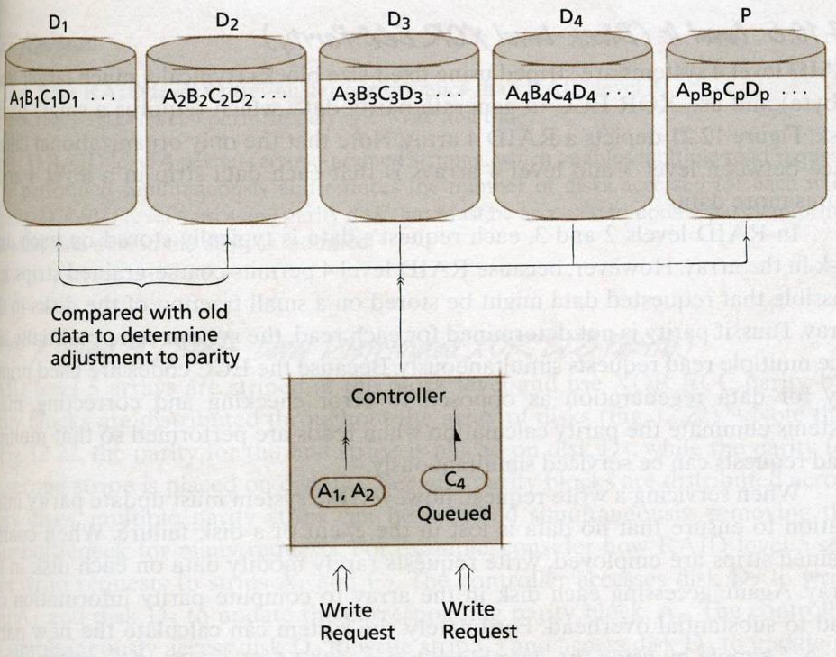
RAID 3
A parity disk is added
it uses only one control bit. It detects one error.
Parity bit is 0 for even number of 1 in the data, 1 for an odd number of 1.
The parity disk is common to all the disks. Is this a problem?

Slide 17
RAID 3 – The bottleneck problem
Storage efficiency: only 1 disk used for control. So, (N-1)/N. with N=10 storage efficiency is 90%
Fault Tolerance: one disk failure (what we need..).
Cost: hardware controller required
Performance
Writing: quite bad. Control bits must be computed for every stripe and written. Even if part of the stripe is written (in that case all the stripe must be read before writing)
Reading: read data, compute parity, read parity and compare to check errors

Slide 18
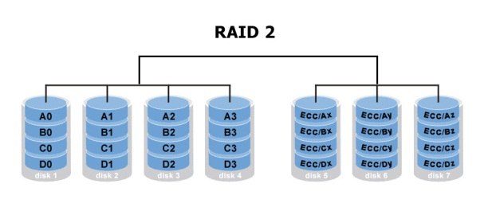
RAID 2 – Correcting Errors
Rarely used
Instead of one parity bit, many of them are used to detect and correct errors. The most used method is called Hamming Code
The Hamming code many control bits (and thus many supplementary disks)
Storage efficiency: low. It depends on the disk number. With 4 data disks 3 control disks. Efficiency is 57% (4/7). For 10 disks 4 control disk, efficiency is 71%.
Fault Tolerance: 2 disks can break.

Slide 19
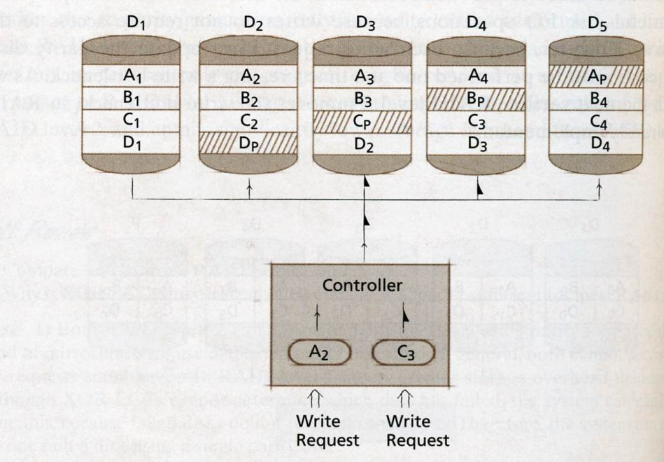
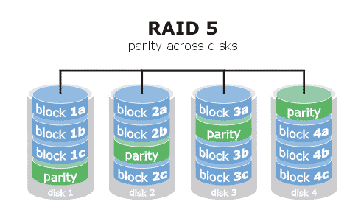
RAID 5
The most popular. Parity blocks are striped as well. Removes the bottleneck on the parity disk!

Slide 20
RAID 5
Storage efficiency. like RAID 3.
Fault Tolerance like RAID 3
Performance. Writing is improved if parity disks are different. Again, all the stripe must be read to compute parity.
AFRAID techniques (parity computed every X ms instead of every time)
Cost: fair

Slide 21
Exercise
Parity. Add the parity bit:
00101101?
Why RAID 5 avoid part of the bottleneck on the parity disk?
Can I perform simultaneous writing with RAID 3 or 5?
Consider a system in RAID 3. Describe the sequence of operations needed to:
Write two files on the same stripe
Write two files on different non overlapping stripe

Slide 22
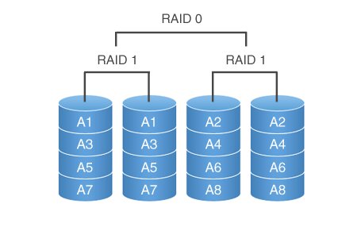
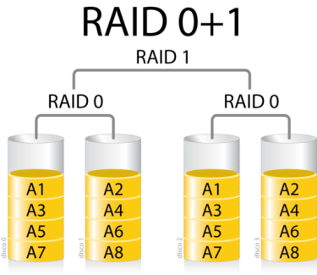
RAID 10 and RAID 0+1
Combination of RAID 0 (for performance) and RAID 1 (for reliability)
RAID 10: first RAID 1 then RAID 0
RAID 0+1: first RAID 0 then RAID 1
Difference. RAID 10 has advantages: what if a disk fails? Stripe is not accessible while mirror is

Slide 23
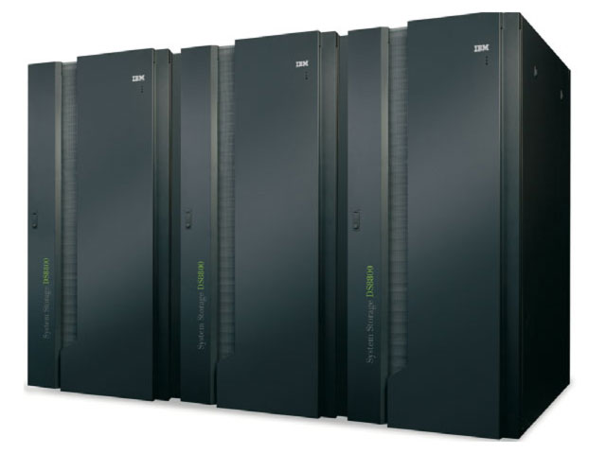
RAID 10 and RAID 0+1
Low Storage Efficiency (50%)
Good performance due to striping
Good reliability due to mirroring
High Cost
RAID 10 is Industry Standard
Storage server containing arrays of disks connected by optical fibres and connected to a server farm via a dedicated private network (SAN)

Slide 24
Exercise
How many disks are needed if you have 10GB disks and you need to store 60GB
RAID 0:
RAID 1:
RAID 3 or 5:
RAID 10:
RAID 0+1:

Slide 25
Comparison
RAID LEVEL | Storage Efficiency | Performance | Write Concurrency | Read Concurrency | Redundancy | Costs
0 | 100% | High | Y | Y | None | Low
1 | 50% (or lower) | Low | N | Y | Mirroring | High
3 | Medium | Medium | N | Y (N) | Parity | Fair
5 | Medium | Medium | N | Y (N) | Parity | Fair
10 | 50% (low) | High | Y | Y | Mirroring | High
01 | 50% (low) | High | Y | Y | Mirroring | High
RAID 10 slightly better advantages than RAID 0+1

Slide 26
Conclusions
RAID improves performance and reliability
Which one is the best choice?
It is a trade off, it depends on performance required, budget and criticality of data
RAID 10 s the most used standard in industry for big companies with large budget and medium dataset
RAID 5 is popular (cheaper solution but still good performance)
Critical data – such as operating system – are usually mirrored
Non critical data can be striped only
Non critical data with little access do not require RAID

Slide 27
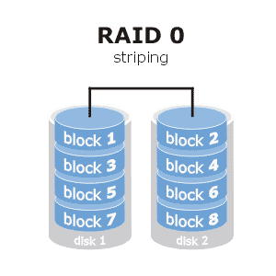
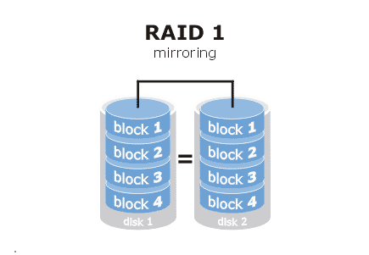
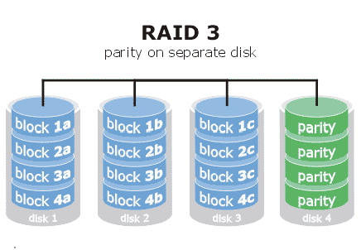
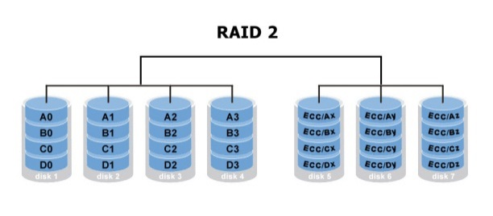
RAID LEVELS
RAID
0 | Striping. Data spread across disks
1 | Mirroring. Each disk has one or more identical copy
3 | Parity disk added
2 | Multiple parity disks to detect and correct more errors
5 | Parity bit spread across multiple disks
10 | Disk are mirrored, then striped (stripe of a mirror)
01 | Disks are striped, then mirrored (mirror of a stripe)

Slide 28
File Organization

Slide 29
Type of File
Database tables are saved on a collections of files
Type of file:
Unordered
Ordered
Clustered
Hashed

Slide 30
Type of File: Unordered
Also called a heap or a pile file.
New records are inserted at the end of the file.
A linear search through the file records is necessary to search for a record.
This requires reading and searching half the file blocks on the average, and is hence quite expensive.
Record insertion is quite efficient.
Reading the records in order of a particular field requires sorting the file records.

Slide 31
Ordered Files
Also called a sequential file.
File records are kept sorted by the values of an ordering field.
Insertion is expensive: records must be inserted in the correct order.
It is common to keep a separate unordered overflow (or transaction) file for new records to improve insertion efficiency; this is periodically merged with the main ordered file.
A binary search can be used to search for a record on its ordering field value.
This requires reading and searching log₂ of the file blocks on the average, an improvement over linear search.
Reading the records in order of the ordering field is quite efficient.

Slide 32
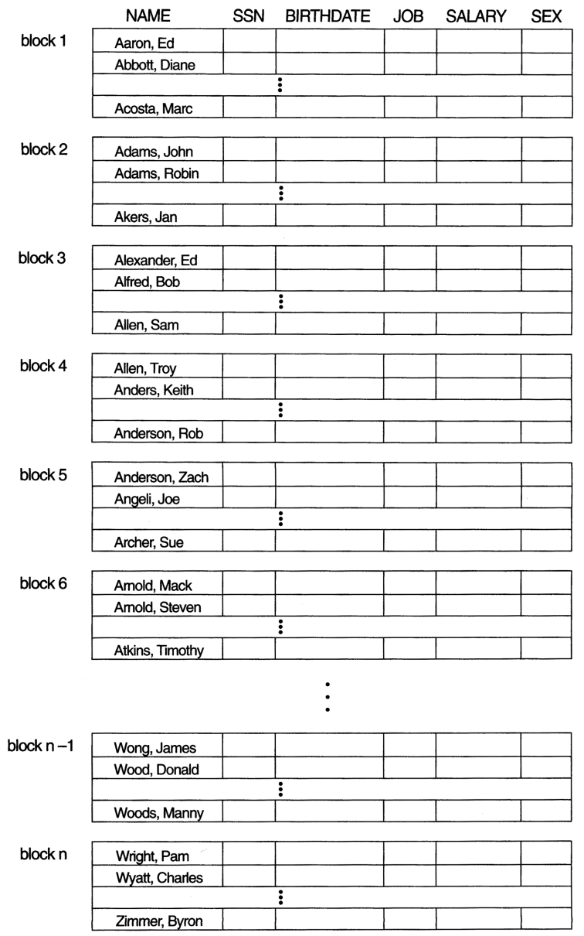
Ordered Files

Slide 33
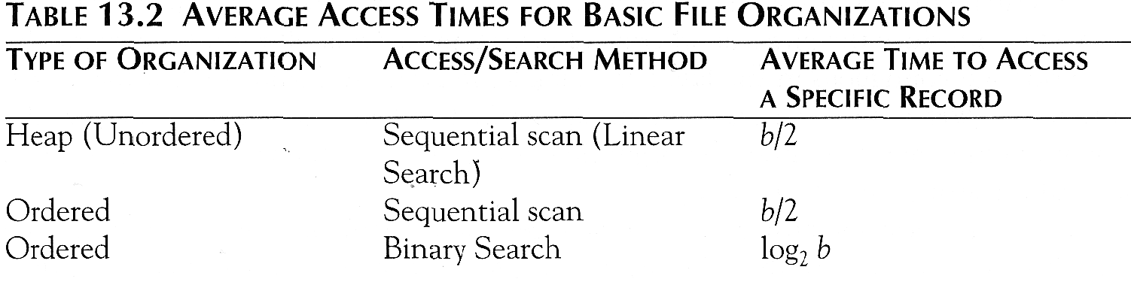
Average Access Times
The following table shows the average access time to access a specific record for a given type of file

Slide 34
Hashed Files
The file blocks are divided into M equal-sized buckets, numbered bucket₀, bucket₁, ..., bucket_{M-1}.
Typically, a bucket corresponds to one (or a fixed number of) disk block.
One of the file fields is designated to be the hash key of the file.
The record with hash key value K is stored in bucket i, where i=h(K), and h is the hashing function.
Search is very efficient on the hash key.
Collisions occur when a new record hashes to a bucket that is already full.
An overflow file is kept for storing such records.
Overflow records that hash to each bucket can be linked together.

Slide 35
Hashed Files (contd.)
There are numerous methods for collision resolution, including the following:
Open addressing: Proceeding from the occupied position specified by the hash address, the program checks the subsequent positions in order until an unused (empty) position is found.
Chaining: For this method, various overflow locations are kept, usually by extending the array with a number of overflow positions. In addition, a pointer field is added to each record location. A collision is resolved by placing the new record in an unused overflow location and setting the pointer of the occupied hash address location to the address of that overflow location.
Multiple hashing: The program applies a second hash function if the first results in a collision. If another collision results, the program uses open addressing or applies a third hash function and then uses open addressing if necessary.

Slide 36
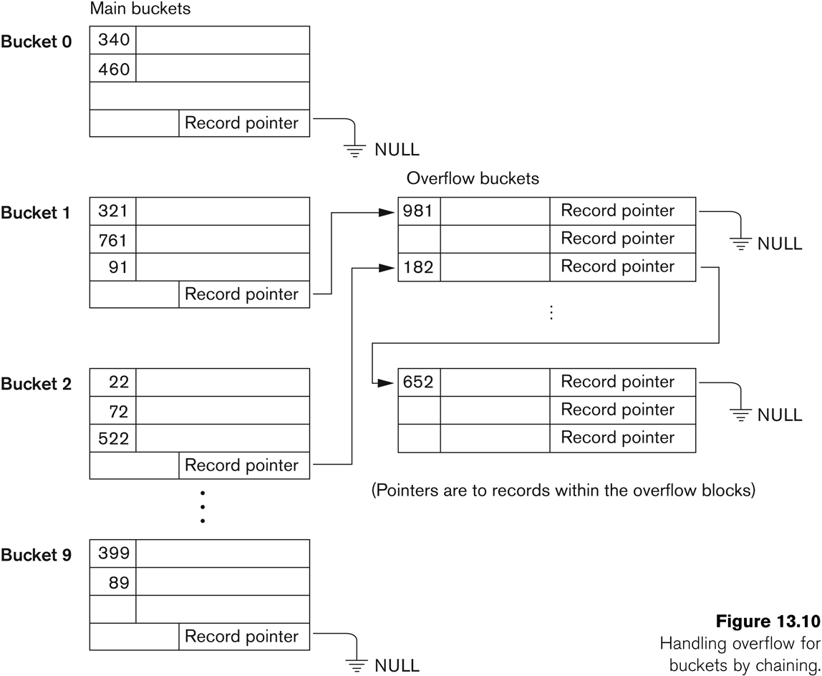
Hashed Files - Chaining

Slide 37
Hashed Files (contd.)
To reduce overflow records, a hash file is typically kept 70-80% full.
The hash function h should distribute the records uniformly among the buckets
Otherwise, search time will be increased because many overflow records will exist.
Main disadvantages of static external hashing:
Fixed number of buckets M is a problem if the number of records in the file grows or shrinks.
Ordered access on the hash key is quite inefficient (requires sorting the records).

Slide 38
Dynamic And Extendible Hashed Files
Dynamic and Extendible Hashing Techniques
Hashing techniques are adapted to allow the dynamic growth and shrinking of the number of file records.
These techniques include the following: dynamic hashing, extendible hashing, and linear hashing.
Both dynamic and extendible hashing use the binary representation of the hash value h(K) in order to access a directory.
In dynamic hashing the directory is a binary tree.
In extendible hashing the directory is an array of size 2^{d} where d is called the global depth.

Slide 39
Dynamic And Extendible Hashing (contd.)
The directories can be stored on disk, and they expand or shrink dynamically.
Directory entries point to the disk blocks that contain the stored records.
An insertion in a disk block that is full causes the block to split into two blocks and the records are redistributed among the two blocks.
The directory is updated appropriately.
Dynamic and extendible hashing do not require an overflow area.

Slide 40
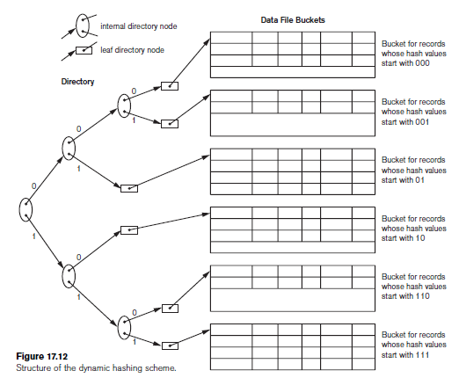
Dynamic Hashing

Slide 41
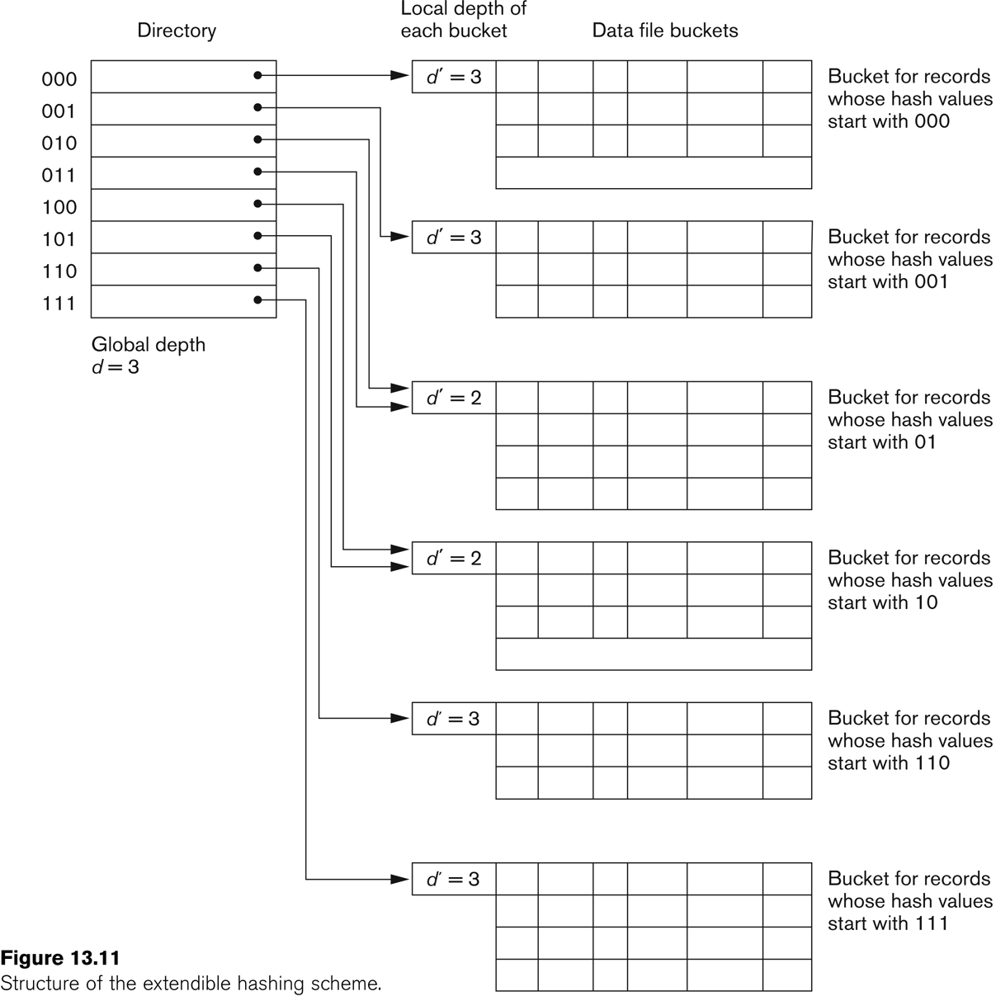
Extendible Hashing

Slide 42
Index Structures for Files

Slide 43
Indexes
Indexes are additional auxiliary access structures with typically provide either faster access to data or secondary access paths without effecting the physical storage of the data.
They are based on indexing field(s) that are used to construct the index.
Indexes can be sparse or dense. A dense index has an entry for each record.

Slide 44
Types of Indexes
Single-Level Indexes
Primary
Secondary
Clustering
Binary
Multi-Level Indexes
B Trees
Notes:
ISAM Indexed Sequential Access Method

Slide 45
Single Level Indexes
A Primary Index is specified on the ordering key field where each tuple has a unique value.
A Clustering Index is specified on the ordering key field where each tuple DOES NOT have a unique value in that field.
A Secondary Index is specified on a NON-ORDERING Field of the file.

Slide 46
Primary Indexes
A Primary Index is constructed of two parts: The first field is the same data type of the primary key of a file block of the data file and the second field is file block pointer.
The Anchor Record or Block anchor is the first record in a file block. This is where the value for the first field of the primary index come from along with the respective address of that block.
Notes:
Mention that this is a sparse index Vs a dense index which has an entry for every key search value.

Slide 47
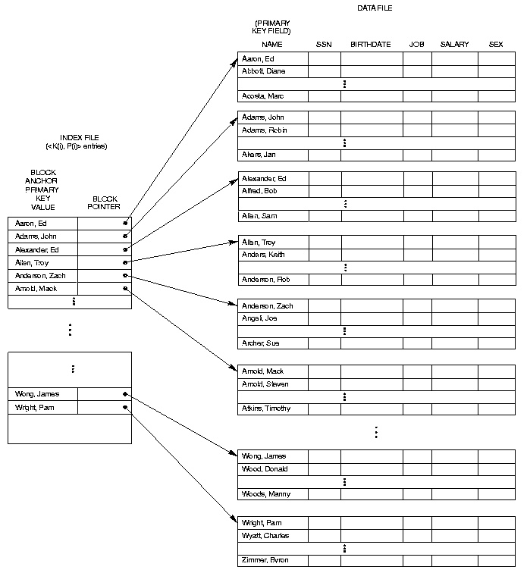

Slide 48
Primary Indexes
The primary index file is usually smaller than the data file it’s indexing because
There are usually fewer index entries than records in the data file (because a block holds more than one record)
The individual index records are smaller than data file records
Binary search on index file is faster than binary search on the database
But slow for insertion and deletion
records have to be kept in order in the data file
AND index file has to be kept in order too

Slide 49
Clustering Indexes
Clustering Indexes are used when the ordering index is not a field where each value is unique.
An entry in the clustering index is composed of a SINGLE entry for each distinct value in the clustering field and its respective file block pointer.

Slide 50
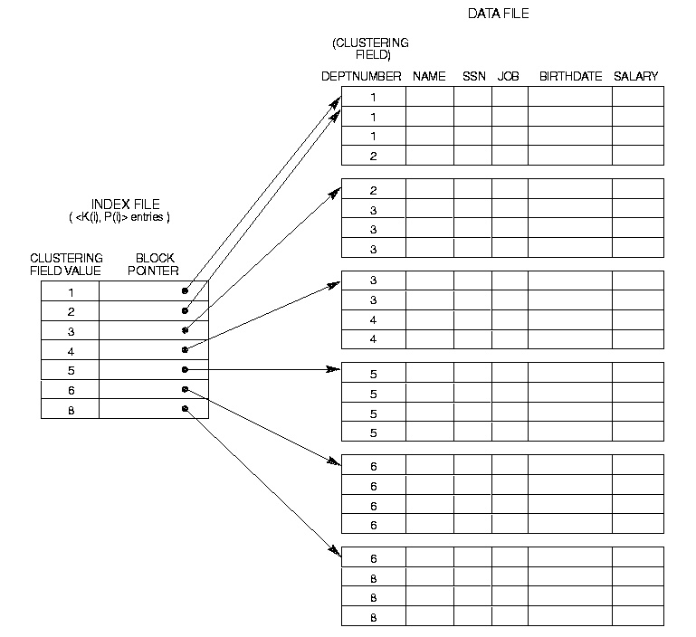

Slide 51
Clustering Indexes, when to use
Return a range of values by using operators such as BETWEEN, >, >=, <, and <=.
e,g, Select all sales with sales order number 120> and <500
SalesOrderNumber can quickly locate the row that contains the starting sales order number, and then retrieve all successive rows in the table until the last sales order number is reached.
For JOIN clauses; typically these are foreign key columns.
For ORDER BY, or GROUP BY clauses.

Slide 52
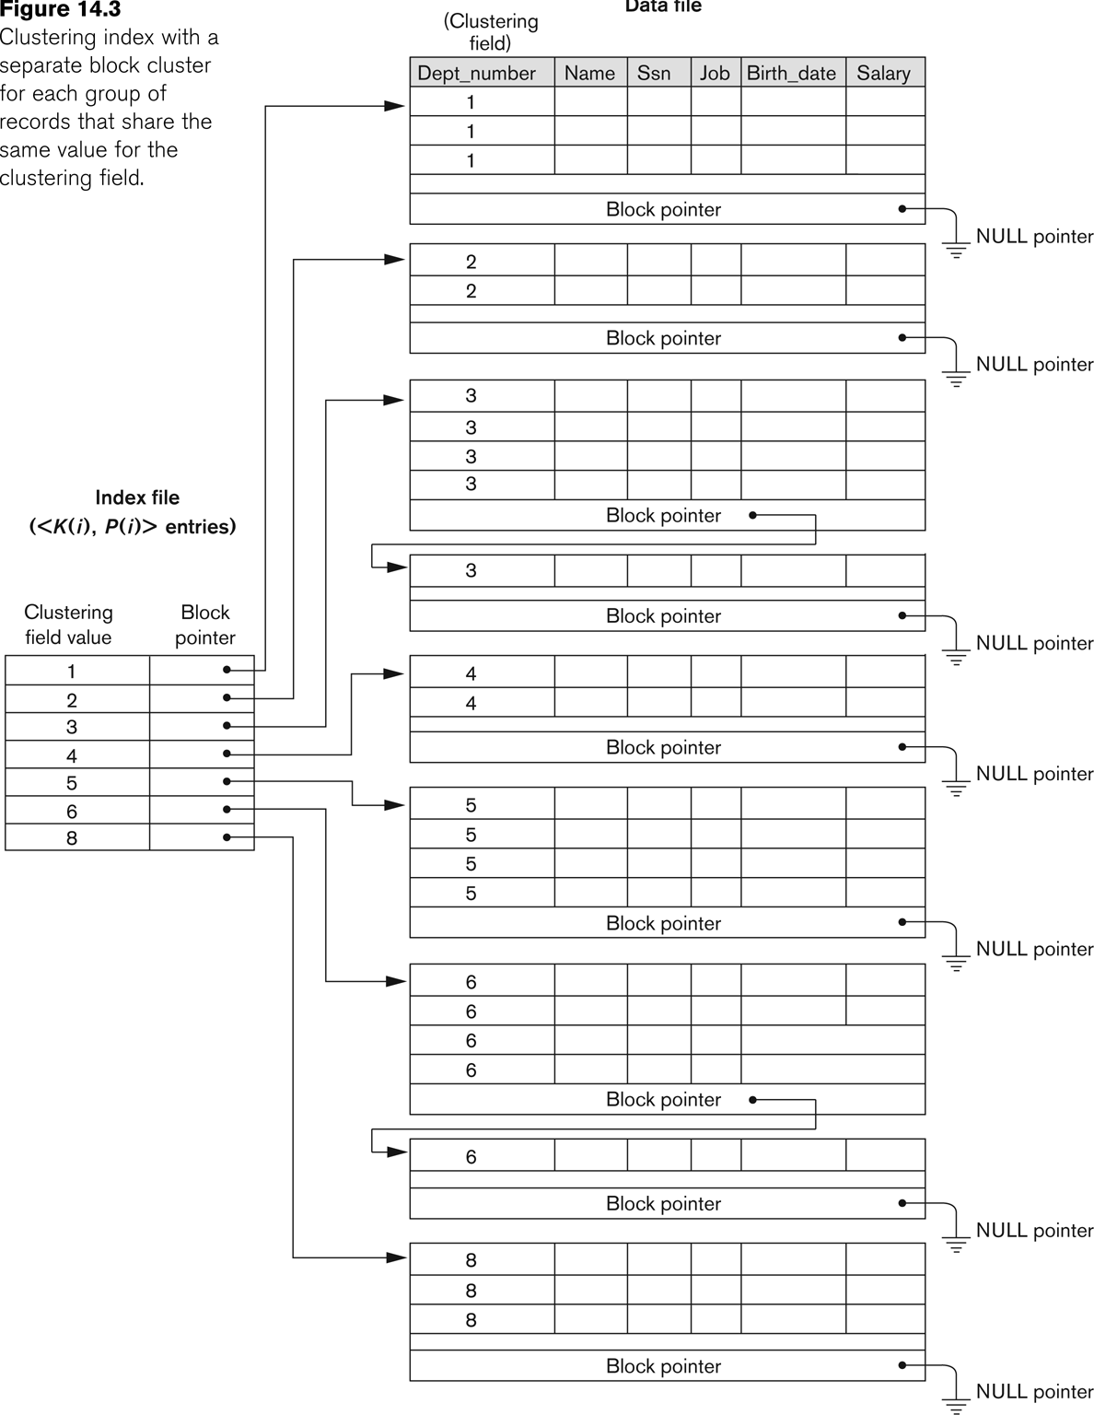
Clustering Index with separate block clusters
Blocks are kept empty for each cluster value to allow for inserts and deletes

Slide 53
Secondary Indexes
An index file that uses a non primary field as an index e.g. Job field in the employee table
They improve the performance of queries that use attributes other than the primary key
You can use a separate index for every attribute you wish to use in the WHERE clause of your select query
But there is the overhead of maintaining a large number of these indexes

Slide 54
Secondary Indexes
A Secondary Index is an ordered file with two fields. The first is of the same data type as some nonordering field and the second is either a block or a record pointer.
If the entries in this nonordering field must be unique this field is sometime referred to as a Secondary Key. This results in a dense index.
For a secondary index, an external index file has a list of pointers to the various values of the indexed column (i.e. It’s a logical index, not physical) so you can have many secondary indexes
What would a secondary index to a telephone directory look like? E.g. Road Name?
WHY would you use a secondary index?

Slide 55
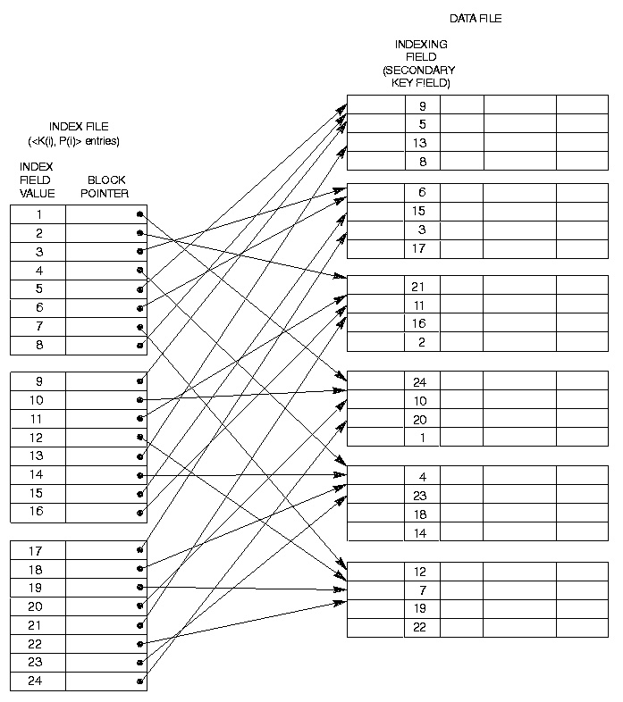

Slide 56
Secondary Index on Non-Key Field
Since there is no guarantee that the value will be unique the previous index method will not work.
Option 1: Include index entries for each record. This results in multiple entries of the same value.
Option 2: Use variable length records with a pointer to each block/record with that value.
Option 3: Have the pointer; point to a block or chain of blocks that contain pointers to all the blocks/records that contain the field value. Example of multi-level index

Slide 57
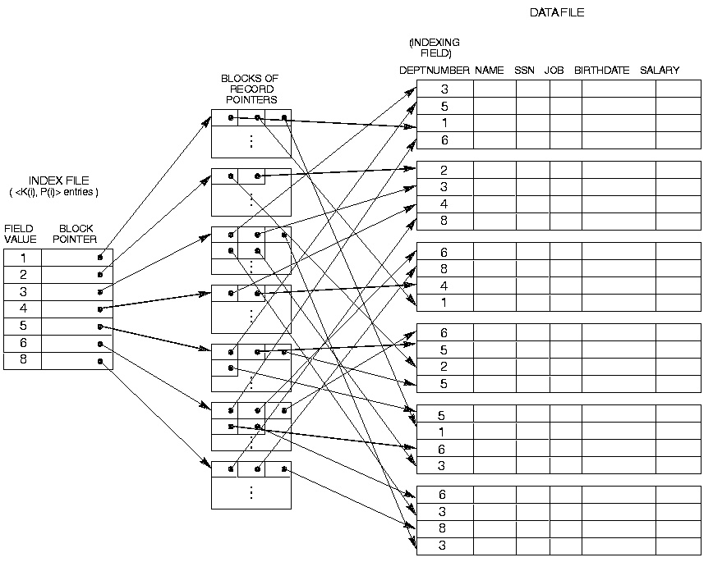

Slide 58
Multilevel Indexes
A Multilevel Index is where you construct an Second- Level index on a First-Level Index. Continue this process until the entire index can be contained in a Single File Block.
This allows much faster access than binary search because at each level the size of the index is reduced by the fan out factor. Rather just by 2 as in binary search.

Slide 59
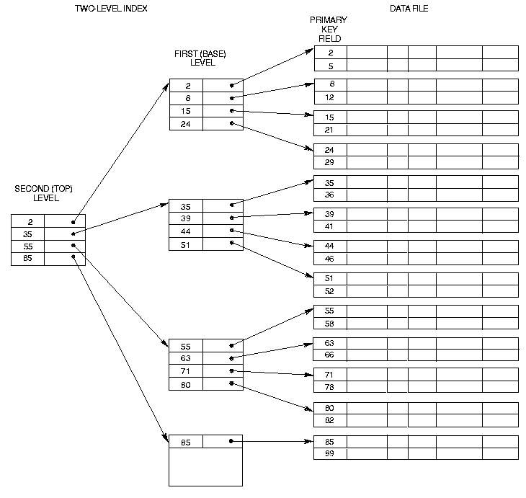

Slide 60
Multilevel Indexes Using Search Trees, B-Trees & B+ Trees
A Search Tree of order p differs from a Multilevel Index in that each node contains a most p - 1 search values and p pointers.
There is no requirement that the Search Tree be Balanced.

Slide 61
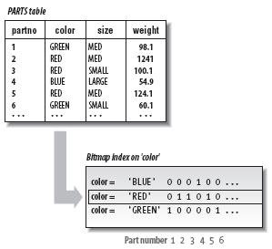
Bitmap Index
An index implemented as a map of bits
Each unique entry in the index is a string of bits
Usually used on fields that are not (or rarely) modified
Fields with low cardinality
Used in read-only environment like data warehouses
Typical example: day of the week, gender,…
How many bytes is a bitmap index on:
Day of the week for 10 millions records
Gender for 1 billion records

Slide 62
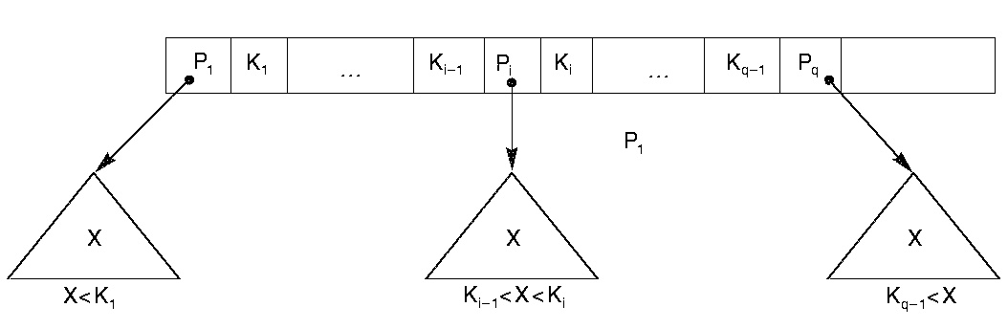

Slide 63
B-Trees
B-Trees address the problems with Search Trees in that they have the additional constraint that they be balanced and they contain pointers to data records.
Each B-Trees is made up of at most P tree pointers and P-1 field values K and data pointers Pr.

Slide 64
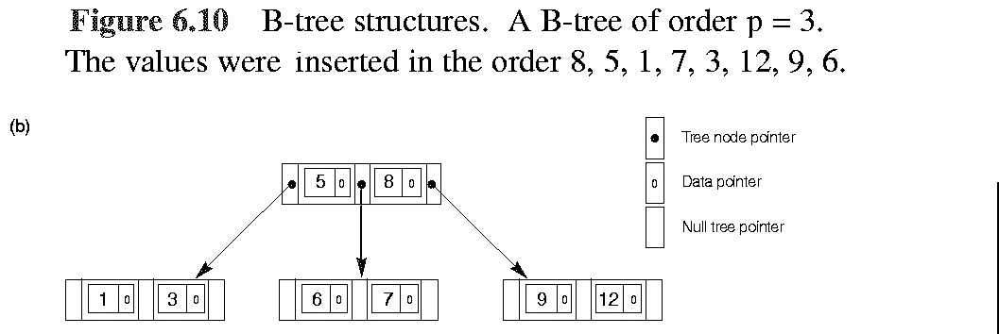

Slide 65
TRIGGERS

Slide 66
What is a trigger?
A block of code that is attached to an event. When that event occurs the trigger code is fired.
A stored block with [Declare], Begin, End.
Associated with a database table or action
Fires automatically when certain DML action is carried out on the table
Before or after an event
Change may be INSERT, DELETE, UPDATE
Do we want to perform on multiple rows?
If not, then Statement level trigger fires once only
If so, then Row level trigger fires for each affected row

Slide 67
Trigger Uses
Auditing
Write information about (sensitive) data modifications to an audit table
May include old and new values, user, timestamp
E.g. new and old salary
Data Integrity
Implement checks on data against business rules
Can compare with live database values
NEW and OLD values can be compared
E.g. prices must not go down

Slide 68
Trigger Uses
Referential integrity
Allows implementation of a "cascade update"
E.g. if author ID (aID) is changed, appropriately change authID in foreign key
Derived data
Update any stored derived data when base data changes
E.g. if total number of employees is stored, add 1 if new employee added

Slide 69
Trigger Uses
Security
Logging of database access
E.g. date and time each user logs on
E.g. deny access at weekend
Maintaining synchronous replicates
In a distributed database
Generating statistics on table access

Slide 70
Types of Trigger and Naming
Statement or Row triggers
So 4 types can be triggered:
Before Statement, Before Row
After Statement, After Row
Naming them
Must be unique within a schema
Can have same name as table on which it is defined but this may be confusing to developers

Slide 71
Statement Triggers
CREATE OR REPLACE TRIGGER trig_testTable
AFTER INSERT or UPDATE ON Personnel
BEGIN
If Inserting
Then INSERT into testTable values ('insert done', SYSDATE) ;
Else
INSERT into testTable values ('update done', SYSDATE) ;
End If;
END;
Inserting, Deleting and Updating can be used to find out which event is occurring
The statement level trigger is useful for INSERT as it only involves a single row whereas DELETE and UPDATE often deal with many rows at once
Notes:
To demonstrate use lect schema. Trigger is on personnel_copy table. Use test_1.sql to see the trigger in action

Slide 72
Row trigger
Operates on many rows potentially
CREATE OR REPLACE TRIGGER trig_test
AFTER UPDATE OF SNUM ON PERSONNEL
FOR EACH ROW
BEGIN
null; -- write operations here
END;
A Row trigger fires once for every row affected by the DML operation

Slide 73
:OLD and :NEW
When a DML statement changes a column the old and new values are visible to the executing code
This is done by prefixing the table column with :old or :new
:new is useful for INSERT and UPDATE
:old is useful for DELETE and UPDATE
triggers may fire other triggers in which case they are CASCADING. Try not to create too many interdependencies with triggers!

Slide 74
Referential integrity trigger example
CREATE OR REPLACE TRIGGER author_trg
AFTER UPDATE OF aID ON author
FOR EACH ROW
BEGIN
UPDATE Book SET authID = :new.aID WHERE authID= :old.aID;
END;
UPDATE author SET aID='9' WHERE aID='5';
ERROR at line 1:
ORA-02292: integrity constraint (MCTPL.BOOK_FK) violated - child record found
Without trigger – referential integrity prevents changes to aID
Trigger automatically applies corresponding changes to aID in child table
UPDATE author SET aID='9' WHERE aID='5';
1 row updated.
With trigger – changes to aID are now allowed!

Slide 75
Referring to Values which fire the trigger
So remember ………….
While trigger is running, it knows the old and the new values of the record you're updating
You need to specify which you want to refer to
Prefix column name with :new. or :old.
…
AFTER UPDATE OF name ON publisher
…
INSERT INTO publish_audit VALUES(SYSDATE, :new.name, :old.name);
…
A record of what has changed

Slide 76
Example trigger: business rules
CREATE OR REPLACE TRIGGER publish_trg
BEFORE INSERT OR UPDATE ON book
FOR EACH ROW
DECLARE
how_many NUMBER;
BEGIN
SELECT COUNT(*) INTO how_many FROM book
WHERE publisher = :new.publisher;
IF how_many >= 3 then
Raise_application_error(-20000,'Publisher' ||
:new.publisher || 'already has 3 books');
END IF;
END;
Trigger header
PL/SQL Block
Notes:
Trigger is created in lect schema, works on book_copy table. Note column name is pub, not publisher.

Slide 77
Example explained
CREATE OR REPLACE TRIGGER publish_trg
BEFORE INSERT OR UPDATE ON book
FOR EACH ROW
Creates a trigger called publish_trg
Executes before data in book table is added/updated
Can prevent the change if necessary
Not fired if deleting from book table
Following block will execute once for each row
Whenever book table data is changed or added

Slide 78
Example explained
DECLARE
how_many NUMBER;
BEGIN
SELECT COUNT(*) INTO how_many FROM book
WHERE publisher = :new.publisher;
IF how_many >= 3 THEN
Raise_application_error(-20000, ('Publisher ' ||:new.publisher || ' already has 3 books'));
END IF;
END;
Count how many records already exist with the same publisher value as the new record (the one being added or updated)
If count is 3 or more, error fires - Output message and abort transaction

Slide 79
Raise_application_error
Used inside trigger
Purpose:
output an error message and
immediately stop the event that fired the trigger
For example, data insertion
Can include variables/trigger values, see previous slide
E.g. RAISE_APPLICATION_ERROR(-20000,'trigger violated')
label
Message text

Slide 80
The Trigger in use
This should happen
insert into book (ISBN,publisher) values('012345678','McGraw-Hill')
*
ERROR at line 1:
ORA-20000: Publisher 4233 already has 3 books
ORA-06512: at "MCTPL.PUBLISH_TRG", line 7
ORA-04088: error during execution of trigger 'MCTPL.PUBLISH_TRG'

Slide 81
WHEN clause
Optional additional statement to control the trigger
Takes a BOOLEAN SQL expression
Trigger fires if TRUE and not if FALSE
Operates on a ROW level trigger
To prevent the trigger from firing in specific row cases
WHEN (expression)

Slide 82
WHEN Example
create or replace trigger only_nulls
after update on BOOK
for each row
when (old.price is null) -- notice the colon with OLD is not used here
begin
insert into PriceChange values(:old.isbn,:new.price);
end;

Slide 83
Compilation errors
When you create a trigger, Oracle responds
"Trigger created" or
"Warning: Trigger created with compilation errors."
Type in the command SHOW ERRORS on its own to make the error messages visible

Slide 84
What to think about
BEFORE or AFTER?
INSERT, DELETE, UPDATE?
FOR EACH ROW or once only?
Any error conditions/messages?
How can I test that the trigger works?

Slide 85
What else can we do with triggers
DROP TRIGGER trigger_name;
No further firing will occur when dropped
ALTER TRIGGER trigger_name DISABLE;
ALTER TRIGGER trigger_name ENABLE;
ALTER TABLE table_name DISABLE ALL TRIGGERS;
ALTER TABLE table_name ENABLE ALL TRIGGERS;

Slide 86
Trigger problems
Easy to confuse := with = with = :old
Compilation errors: use SHOW ERRORS to see them
Errors may need to be solved in a different place from where they occur
"table is mutating"

Slide 87
Getting the code
SELECT text FROM user_source WHERE name ='SAL_TRG';
trigger sal_trg
after update on personnel_copy
for each row
when (old.salary > 20000 and old.bonus is not null)
begin
if inserting then
insert into audit_salaries values(null,:new.salary);
elsif deleting then
insert into audit_salaries values(:old.salary, null);
else
insert into audit_salaries values(:old.salary,:new.salary);
end if;
end;

Slide 88
Triggers are in the Data Dictionary
Info about your triggers is held in USER_TRIGGERS etc.
Trigger_name | Name of trigger
Triggering_event | INSERT, UPDATE, DELETE
Table_owner | Owner of the table attached to
Table_name | Name of the table attached to
Referencing_names | Names used for OLD and NEW
Status | Disabled or Enabled
Description | Trigger description
Trigger_body | Statements executed when fired

